Slide 1
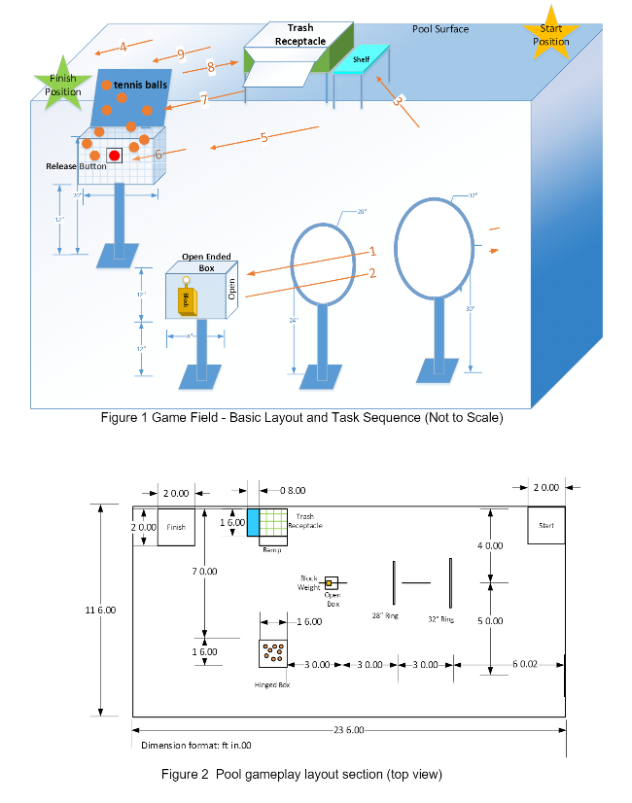
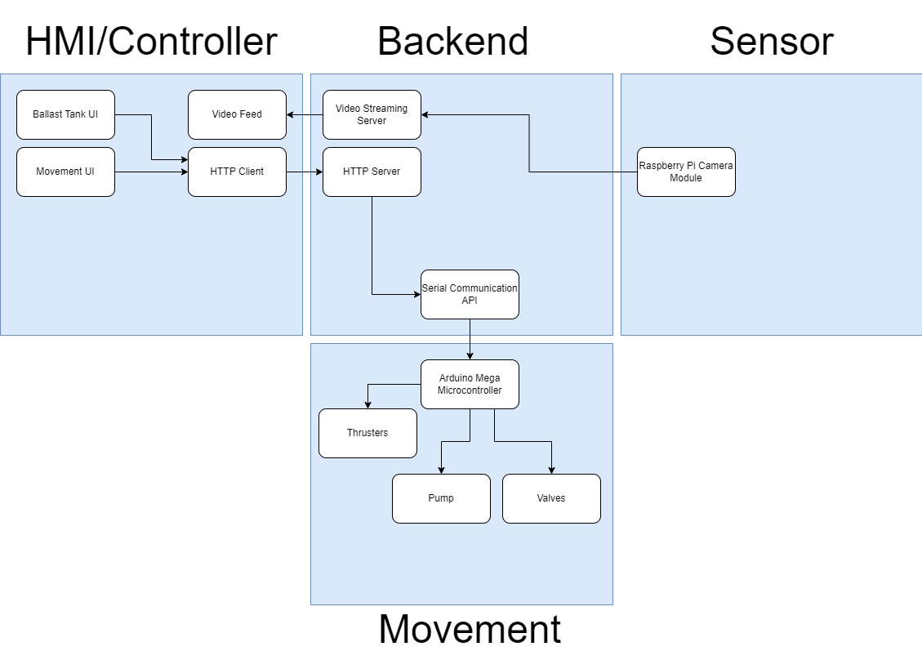
The Drowning Robots
IEEE Robotics Competition
Sponsor: Chris Conly
Team: Joanne Mathew, Apar Pokhrel, Hunter Redhead, Sean Walter
Competition Purpose
Movement Systems
Design Details
The goal of the competition was to design an underwater ROV (Remote Operated Vehicle) to collect trash on the surface of the water, midway below the water, and on the floor of the body of water.
The competition was comprised of two tasks:
To deliver a 3 in. block from the open-ended box and onto the shelf receptacle whilst going through the two hoops.
To hit a button under the surface of the water to release tennis balls, collect the tennis balls, and deliver them to the trash receptacle.
Thrusters
Ballast Tank System
Design/Implementation
The 5D’s is built on the Unity Game engine designed for keyboard and mouse input. The network controller is built through the Mirror library and is designed for local area network connections. The Character Controller, Animation Controller, and Character/Map Selector are all built using object-oriented programming practices utilizing built in, high-level, C# functionality. The playable maps and characters were designed by the developers using purchased, prefabricated assets from the Unity Store.
Competition Arena
ADS Diagram
Current Status/Future Work
Currently game is very bare bones only defaults to one game mode (FFA). Only has a limited number of maps and characters to select from. Characters all handle the same. For future work we would want to expand on maps, character, character abilities, different balls/ball attributes. We would also like to expand the Network component to be available over the internet instead of just local hosting. The issues that the game has aren't game breaking (we hope) but we would like to fix all the different bugs that are present in the game.

